Slide 1
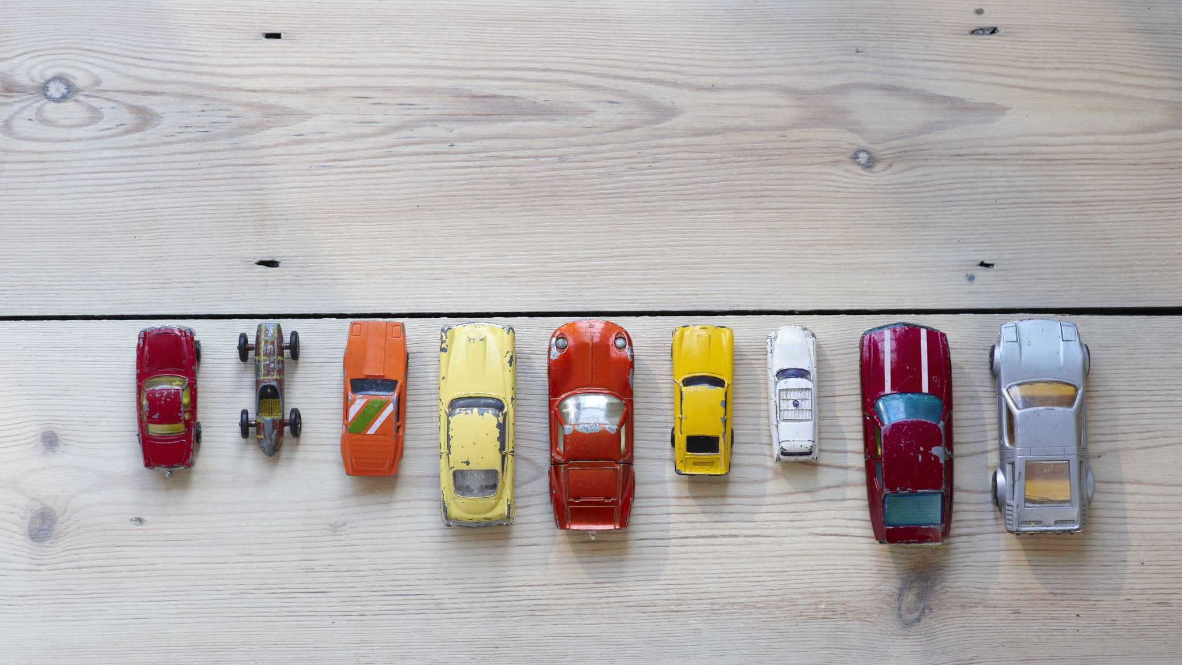
US USED CARS DATASET
CIS5560, Spring 2023 Instructor: Jongwook Woo
Presented by: Group 2 Anusha Valasapalli
Naga Sai Lohitha Karmuru
Rishabh Shah
Wethanie Law

Slide 2

AGENDA
About the dataset
Dataset Specifications
Technical Specifications
Machine learning algorithms used
What is classification and regression
Explanation of algorithms used in the project
Model results comparison table for regression and classification
Summary
GitHub Link and references

Slide 3
ABOUT THE DATASET
Contains three million real world used cars details.
The dataset includes information about the cars' make and model, year of production, mileage, condition, location, and price.
The dataset can also be used to forecast demand for specific car models in different regions and estimate the expenses associated with typical automotive problems.

Slide 4

DATASET SPECIFICATIONS
DATASET NAME: USA Used Car Dataset
TOTAL DATASET SIZE: 2 GB
DATASET FORMAT: CSV
DATASET URL: https://www.kaggle.com/datasets/ananaymital/us-used-cars-dataset

Slide 5

TECHNICAL SPECIFICATION
Databricks Community Version: 9.1 LTS (includes Apache Spark 3.1.2, Scala 2.12)
File System: DBFS (Data Bricks File System)
Nodes: 1
Python Version: 3.10.4
Hadoop Version: 3.2.1
Number of CPU core: 8
PySpark version: 3.0
Number of Nodes: 3
Total Storage: 390.71 GB

Slide 6
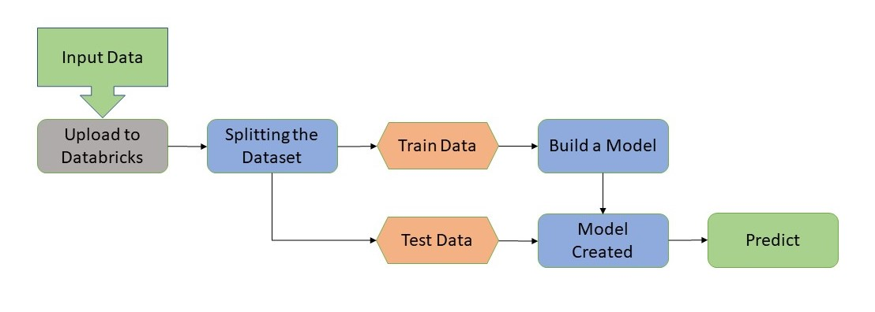
PREDICTION SYSTEM FLOWCHART​

Slide 7
MACHINE LEARNING ALGORITHMS USED
Algorithms:
Linear Regression
Random Forest Regression
Gradient Boost Tree Regression
Decision Tree Classifier

Slide 8
WHAT IS CLASSIFICATION AND REGRESSION?
Classification is a sort of supervised learning in which a categorical or discrete output variable is predicted based on a set of input factors.
Regression is a sort of supervised learning in which a continuous or numerical output variable is predicted based on a collection of input variables.

Slide 9
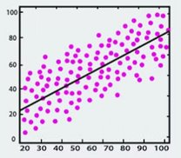
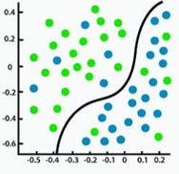
​ | Regression​ | Classification​
Description​ | Predict a continuous quantity​ | Predict some class label​
Type of Response​ | Continuous​ | Categorial​
Assess Value​ | RMSE / R2​ | AUC​
Scatter Plot Exp​ | ​ | ​

Slide 10

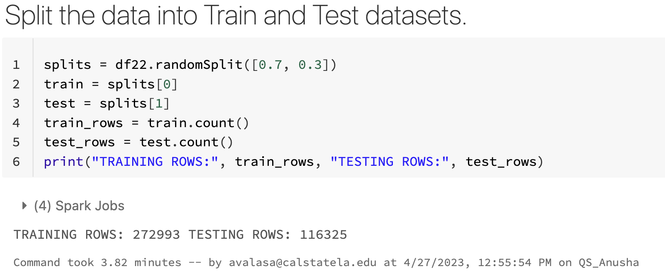
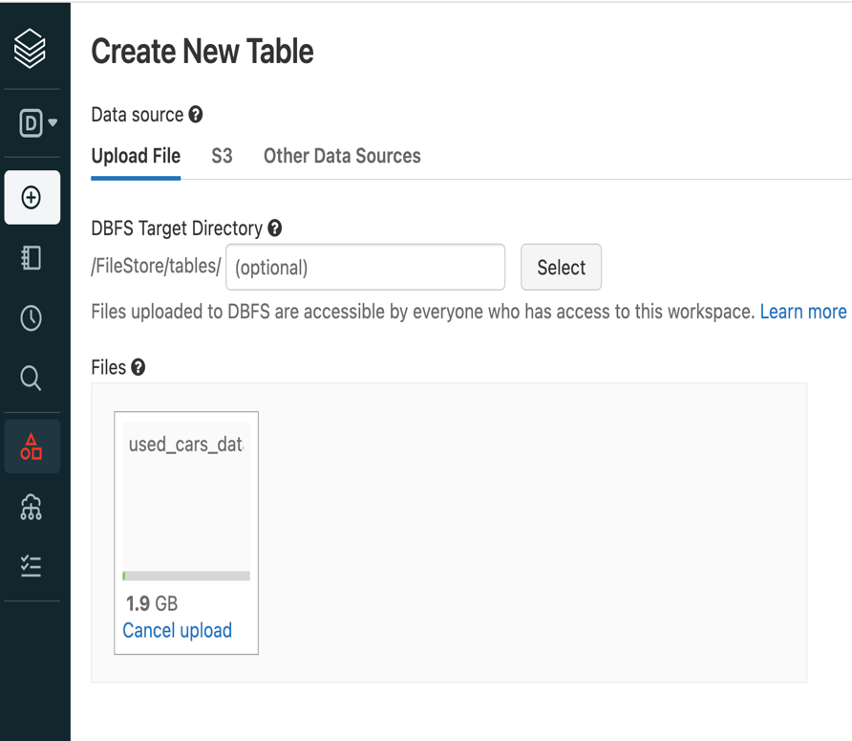
IMPORT & SPLIT DATASET​
Imported 1.9 GB of
the dataset to Databrick
Splitting the dataset into a 70-30 ratio for training and testing respectively

Slide 11
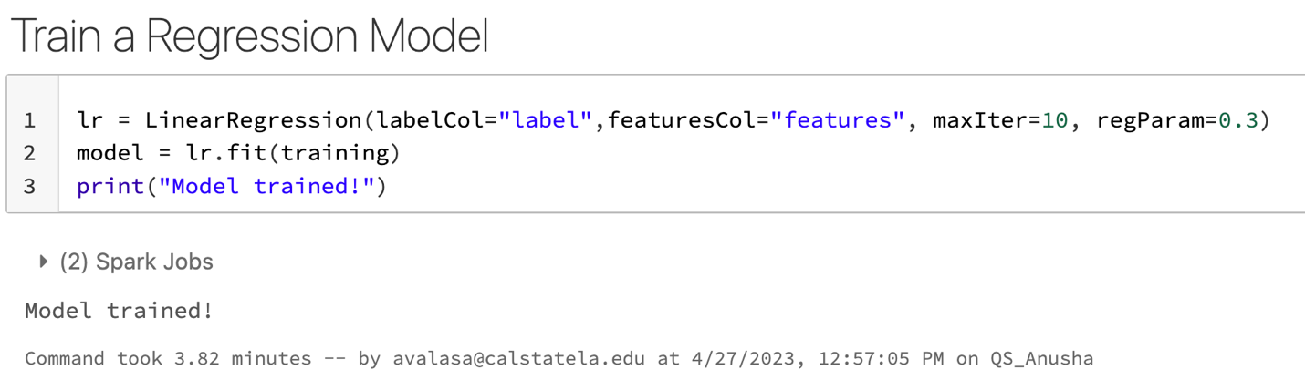
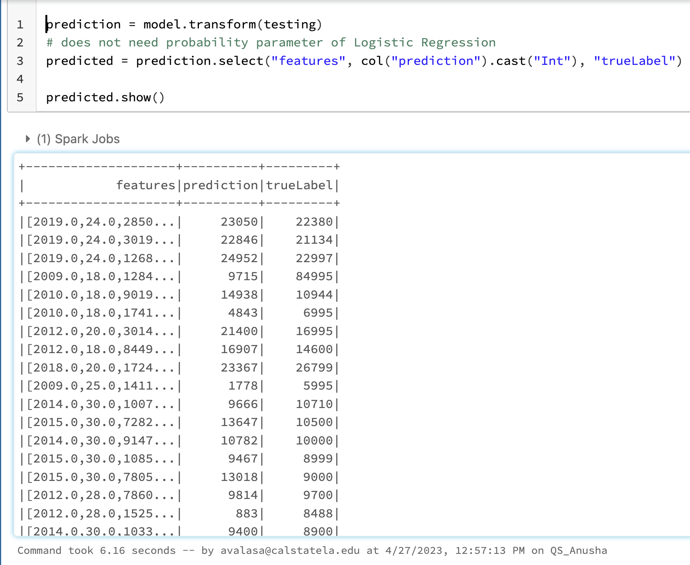
LINEAR REGRESSION​
Training the model used 3.82 min ParamGrid: maxIter 10 regparm 0.3
Test model used 6.16 sec

Slide 12
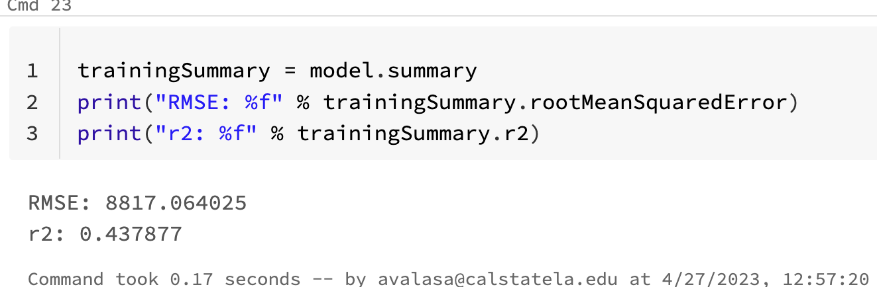
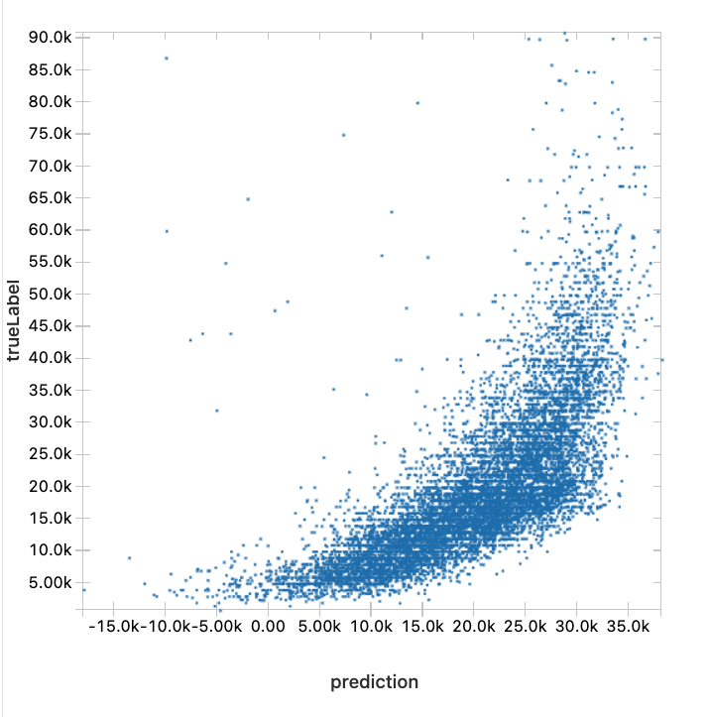
LINEAR REGRESSION RESULT​
RMSE: 8817.064025
R-Squared: 0.437877

Slide 13
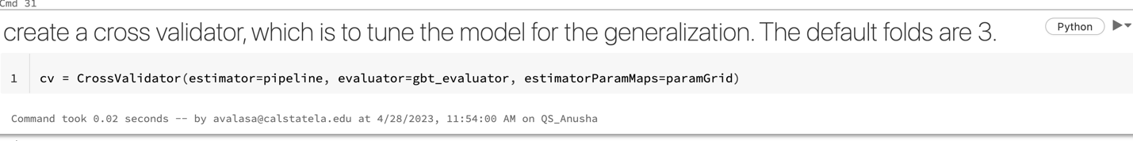
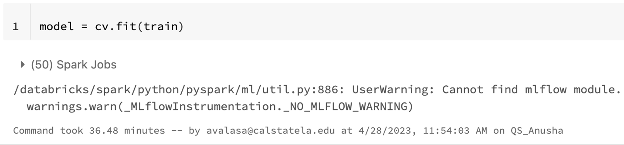
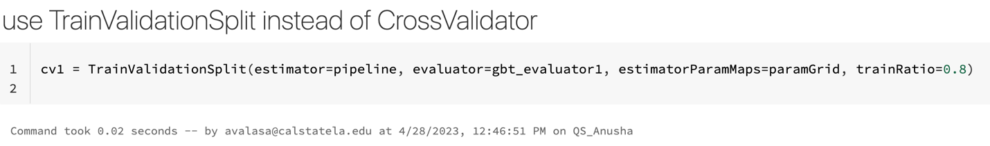
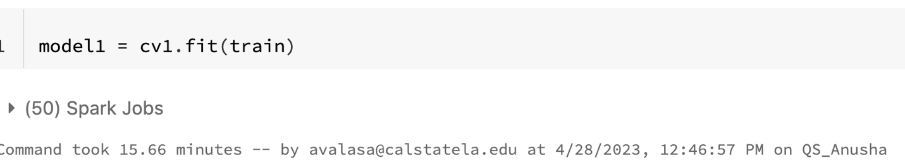
GRADIENT BOOSTED TREE(GBT)​
CV
Training: 36.48min
TVS
Training: 15.66min

Slide 14
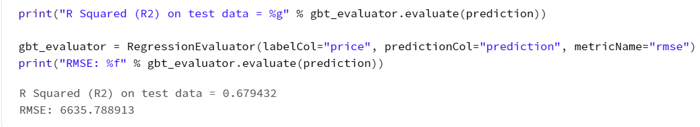
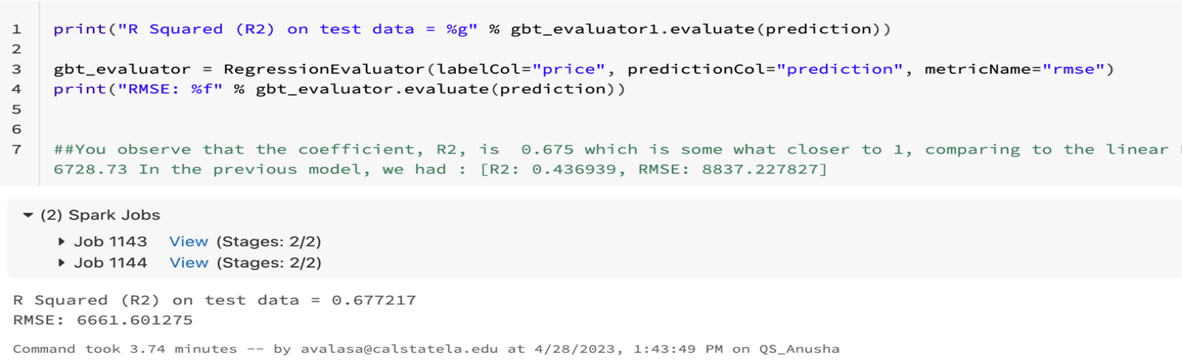
GRADIENT BOOSTED TREE(GBT) RESULT​
CV RMSE: 6635.788913 R-Squared: 0.679432
TVS RMSE: 6661.601275 R-Squared: 0.667217

Slide 15
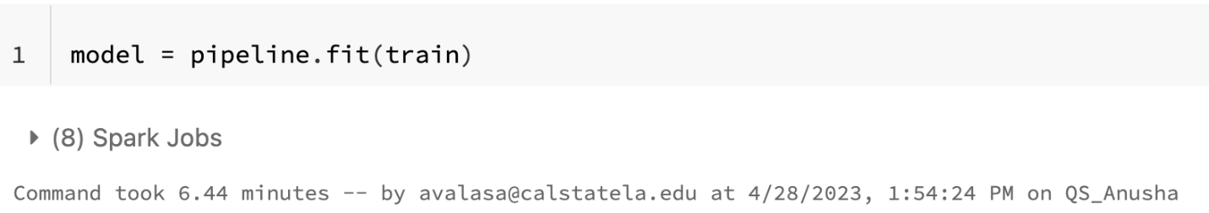
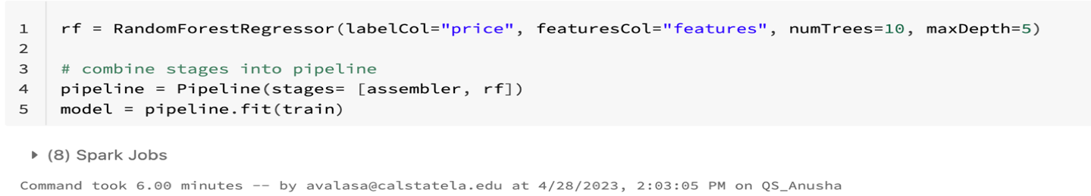
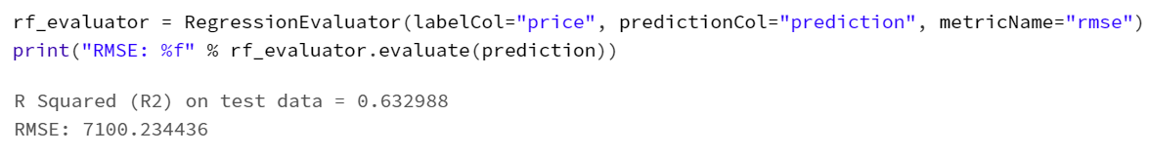
RANDOM FOREST REGRESSOR​
Runtime: 6minutes
RMSE: 7100.234436 R-Squared: 0.632988

Slide 16
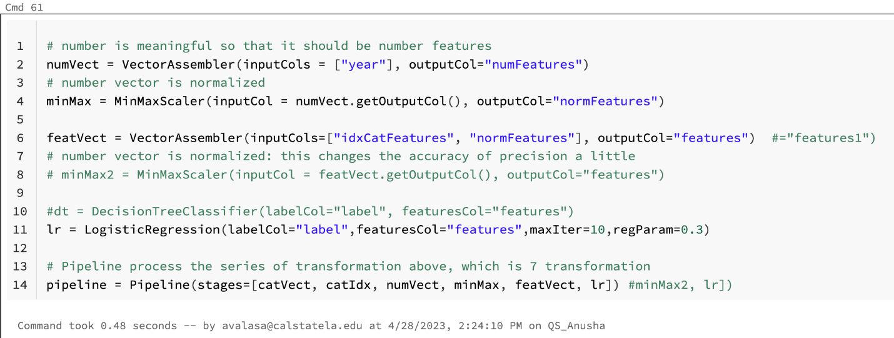
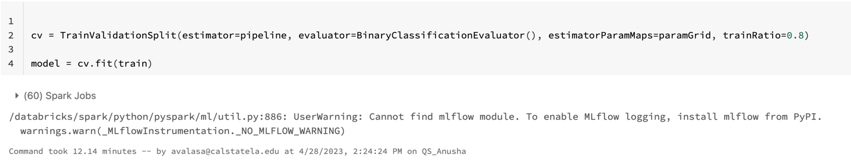
DECISION TREE CLASSIFIER​

Slide 17
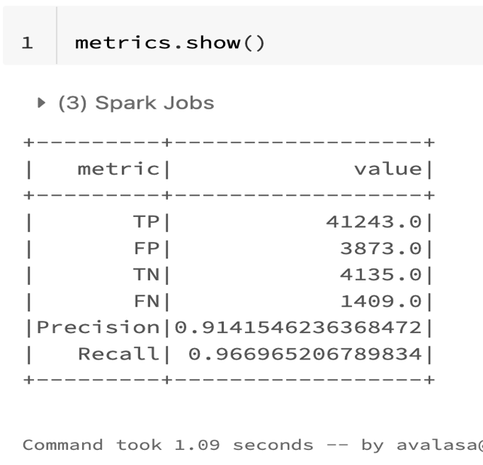
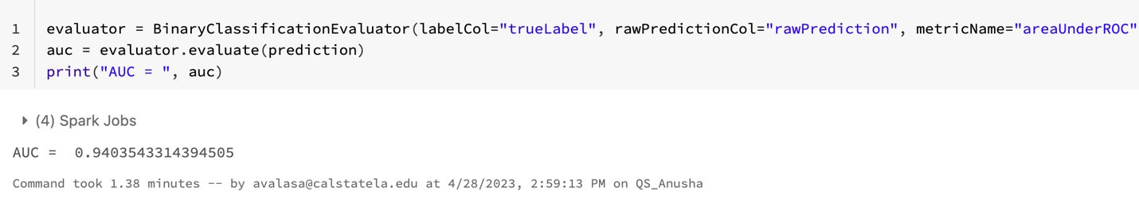
DECISION TREE CLASSIFIER RESULT​
AUC: 0.940

Slide 18
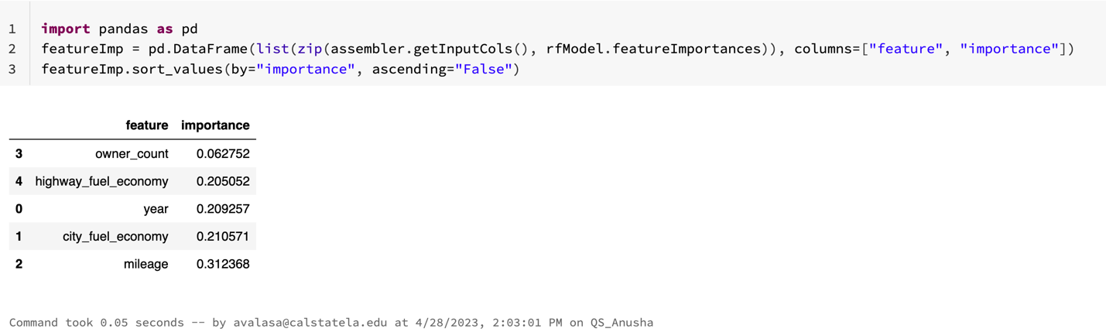
FEATURE IMPORTANCE ​
Mileage has the highest importance score, 0312368

Slide 19
MODEL RESULTS COMPARISON TABLE FOR REGRESSION​
Model | RMSE | R2 | Runtime
Linear Regression | 8817.064025 | 0.437877 | 3.82min
GBT CV | 6635.788913 | 0.679432 | 36.48min
GBT TVS | 6661.601275 | 0.667217 | 15.66min
Random Forest Regressor | 7100.234436 | 0.632988 | 6 min

Slide 20
MODEL RESULTS COMPARISON TABLE FOR CLASSIFICATION​
Model | Precision | Recall | AUC | Runtime
Decision Tree Classifier | 0.914 | 0.966 | 0.940 | 10.55min

Slide 21
SUMMARY
The project involved the use of various machine learning algorithms to investigate patterns and trends in data, forecast prices and demand for various types of cars, and establish pricing models and tactics for sellers and buyers.
The project's findings can help many stakeholders in the used automobile market, such as car dealerships, online marketplaces, and individual buyers and sellers, make better judgments when buying, selling, or pricing used cars.

Slide 22
GITHUB LINK
https://github.com/anushavalasapalli-97/CIS-5560 US_USED_CARS_PROJECT-

Slide 23
REFERENCES
https://spark.apache.org/docs/2.2.0/ml-pipeline.htmlhttps://spark.apache.org/docs/latest/ml-tuning.html
https://www.kaggle.com/datasets/ananaymital/us-used-cars-dataset

Slide 24
THANK YOU

